Slide 1
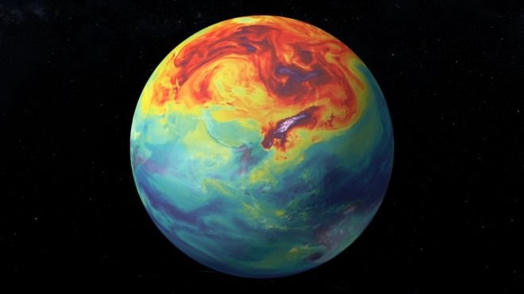

Climate Change 101
Dr. Chris Hennon
Atmospheric Sciences
University of North Carolina Asheville
Climate Teach In
October 20, 2020

Slide 2
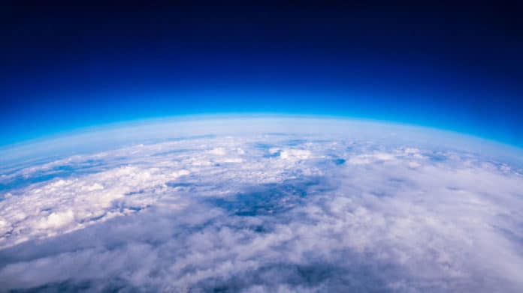
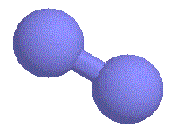
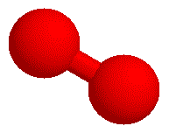
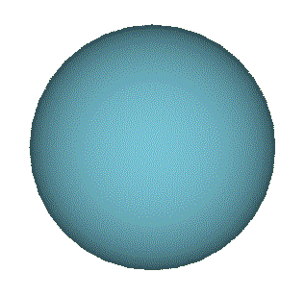
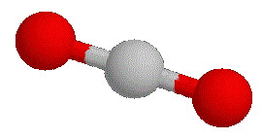
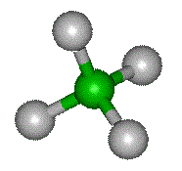
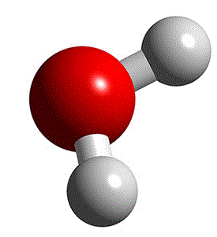
Atmospheric Gases
Permanent Gases
Nitrogen (78%)
Oxygen (21%)
Argon (<1%)
Greenhouse Gases
Carbon Dioxide (0.04%)
Methane (0.0002%)
H₂O Vapor (0-3%)

Slide 3
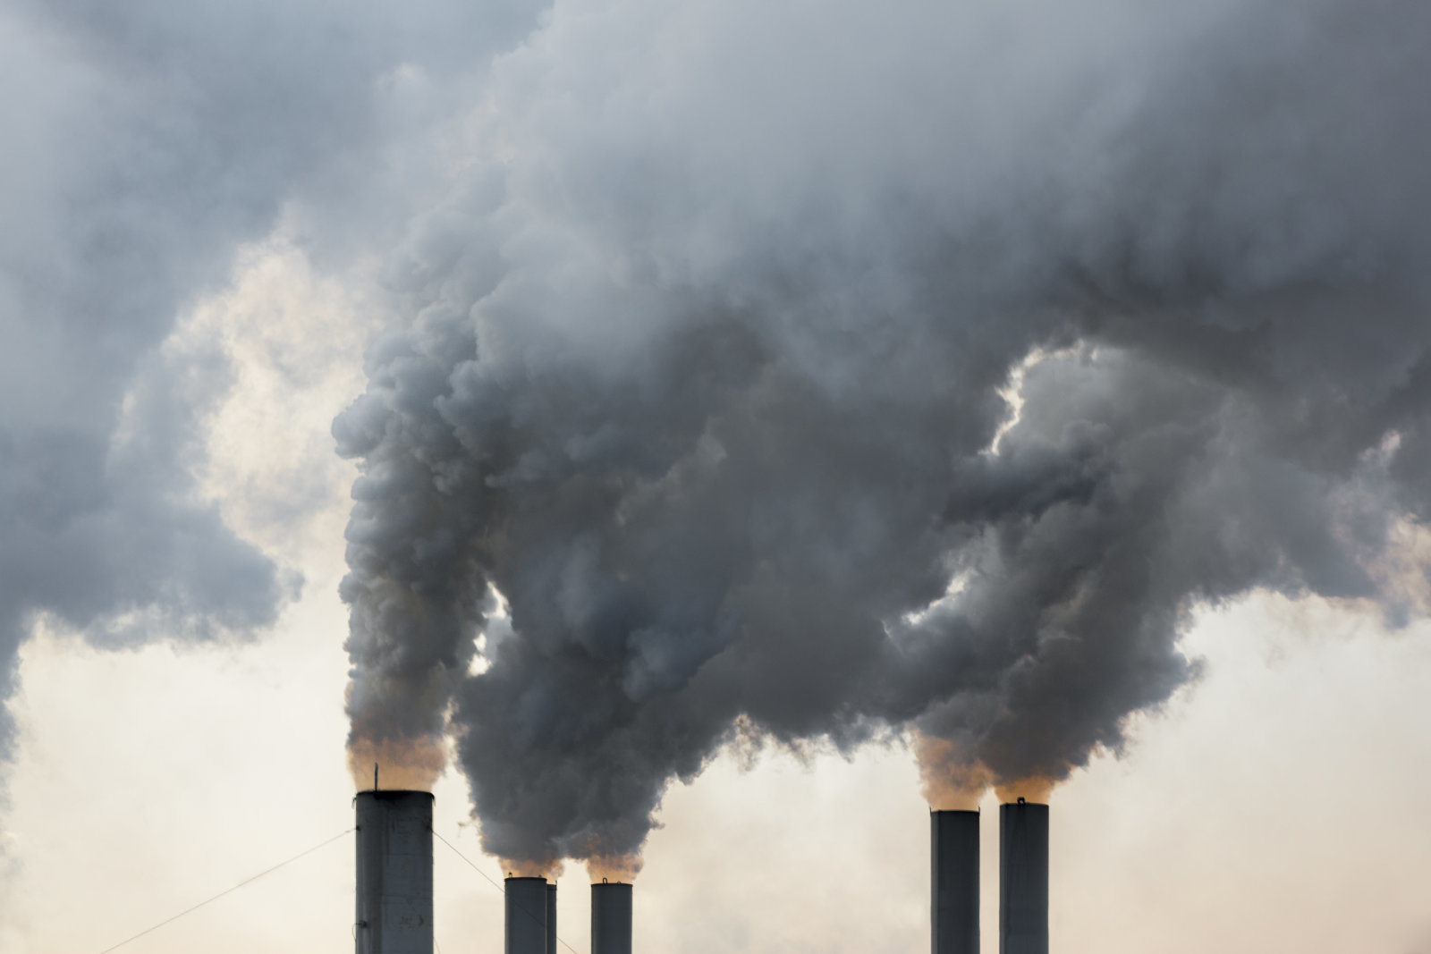

Slide 4
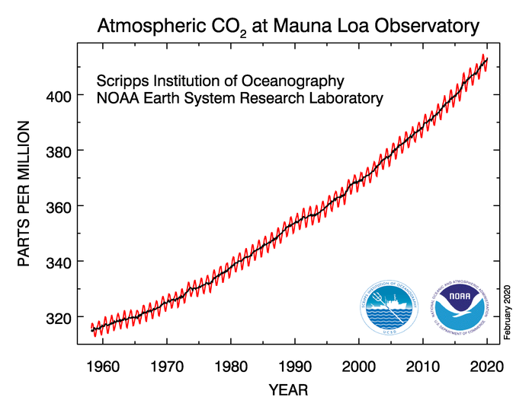
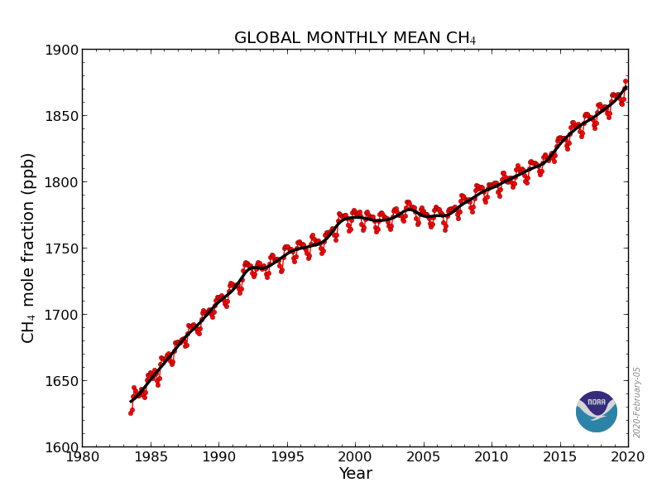
https://www.esrl.noaa.gov/gmd/ccgg/trends/

Slide 5
http://planetforlife.com/images/antarcticrecord.jpg

Slide 6


Sun (Hot)
~5500°C
Earth (not so much)
Longwave Radiation
Shortwave Radiation

Slide 7
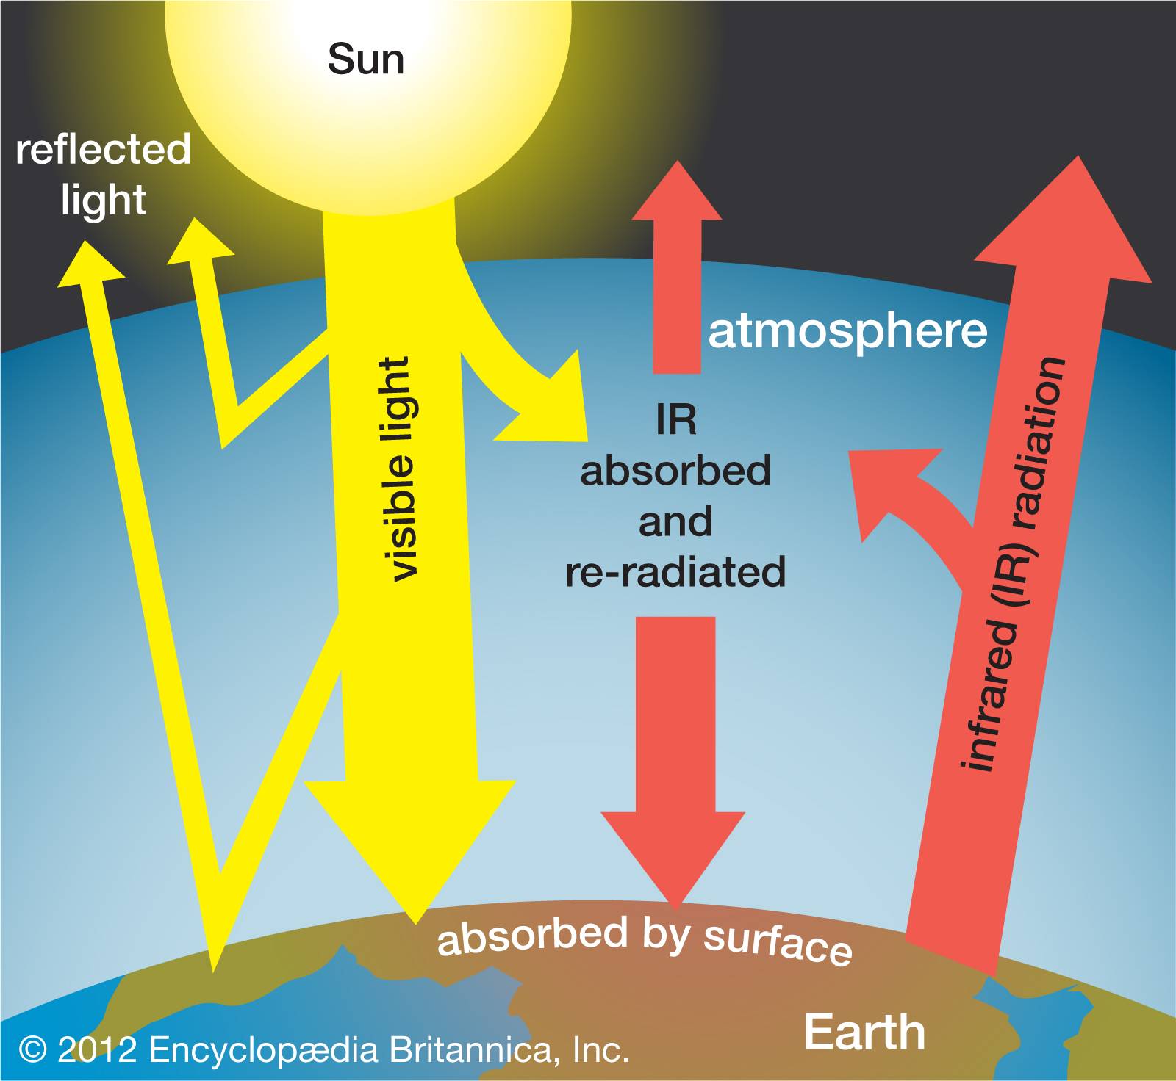

Slide 8
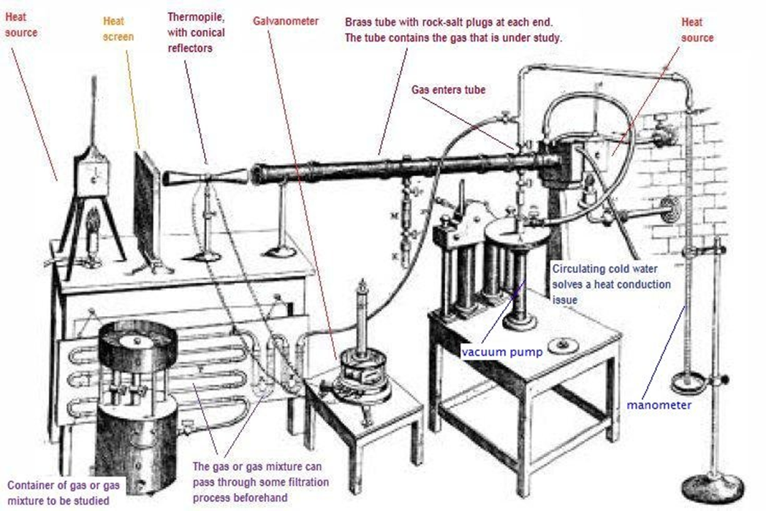
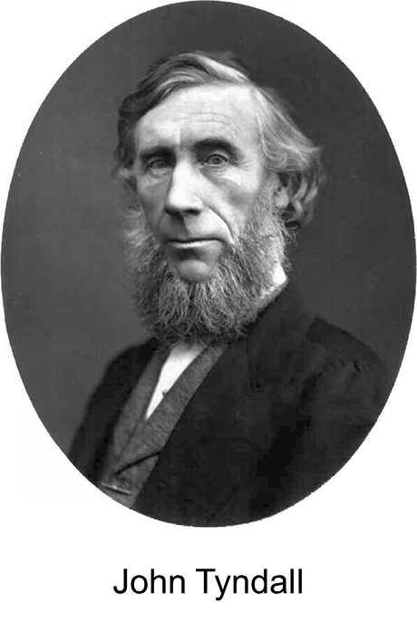
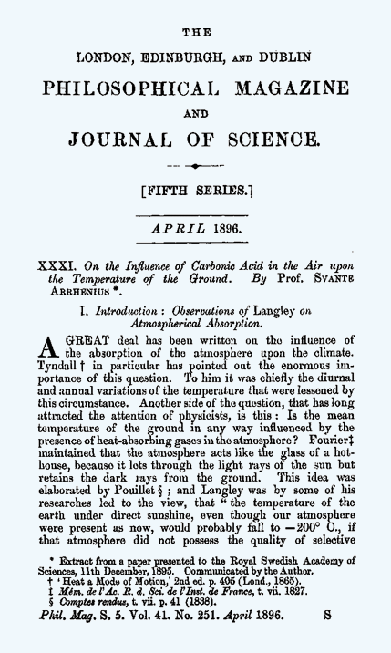
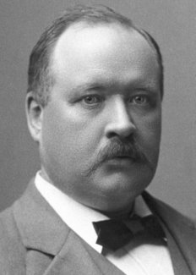
1896
Svante Arrhenius
Notes:
Irish physicist, in 1896 provided experimental evidence that water vapor and other greenhouse gases were efficient absorbers of earth’s radiation.

Slide 9
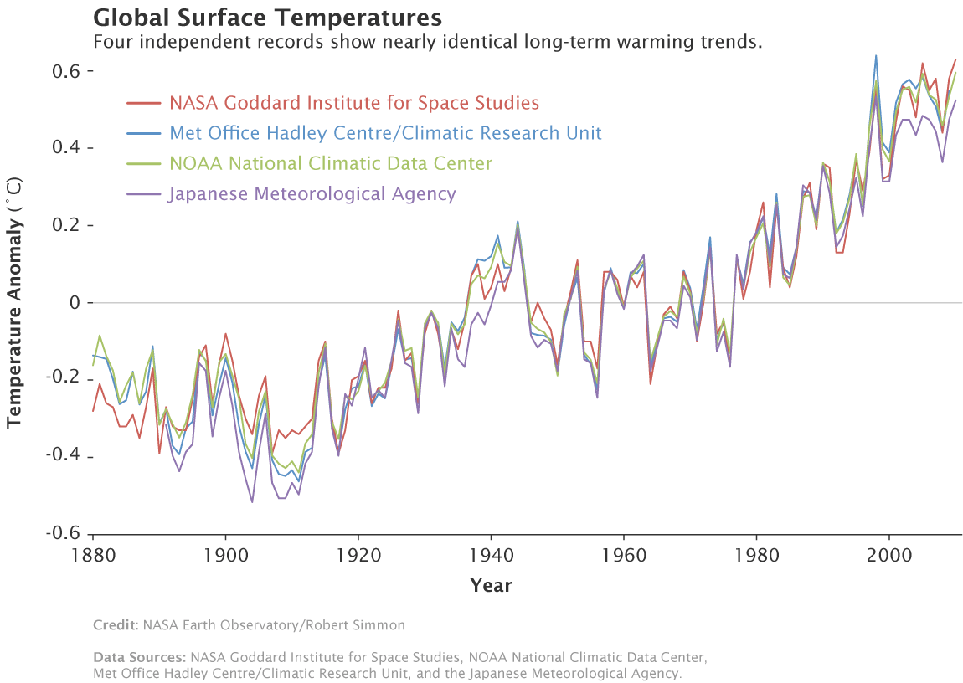

Slide 10
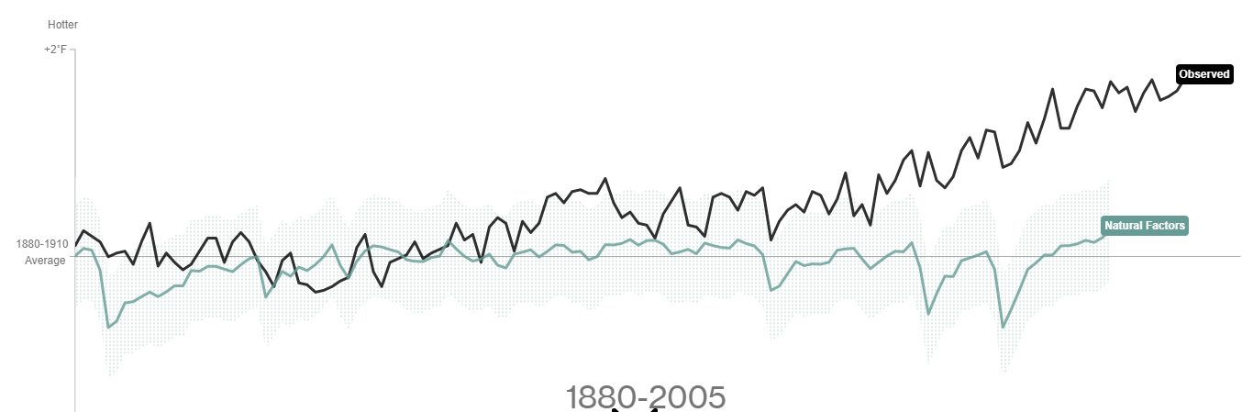
Is It Natural?
NO!

Slide 11
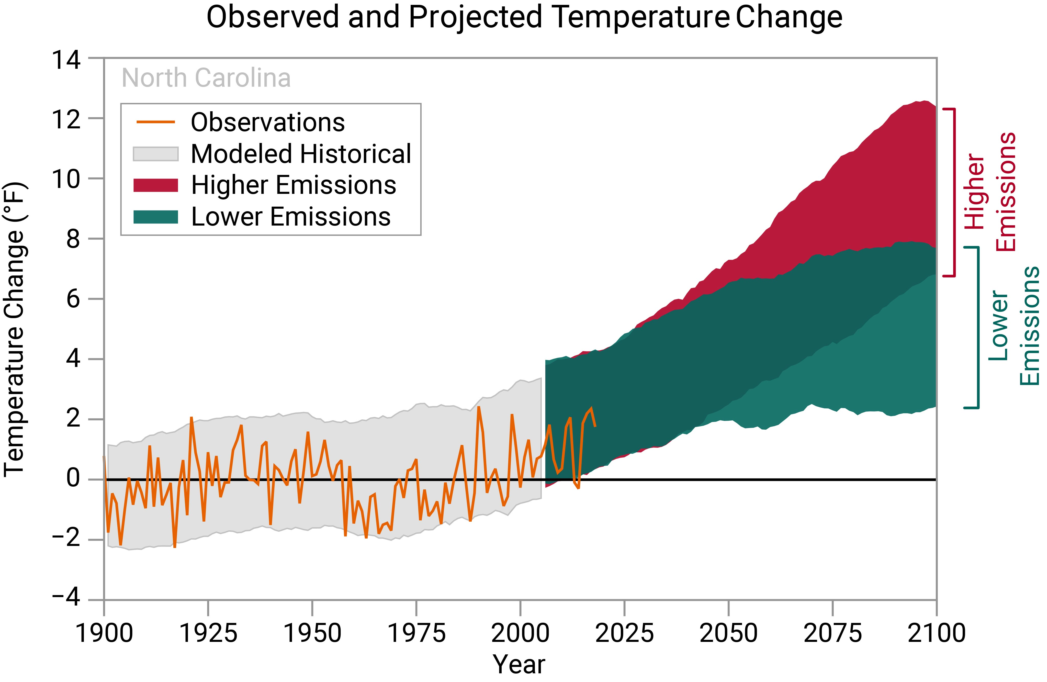
https://statesummaries.ncics.org/chapter/nc/

Slide 12
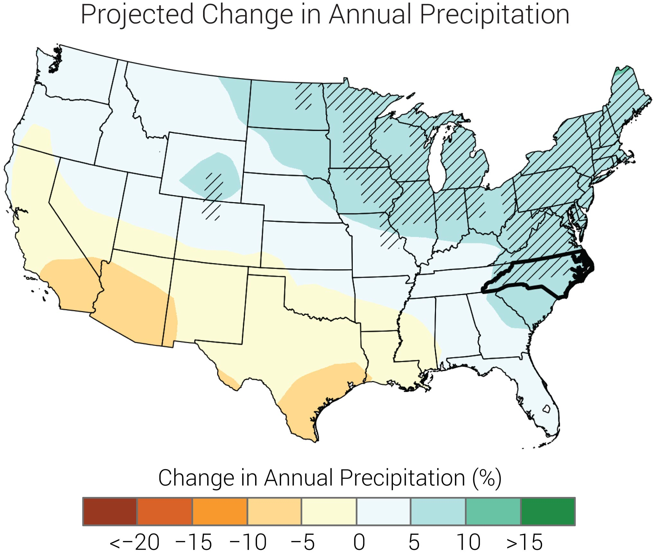

Slide 13
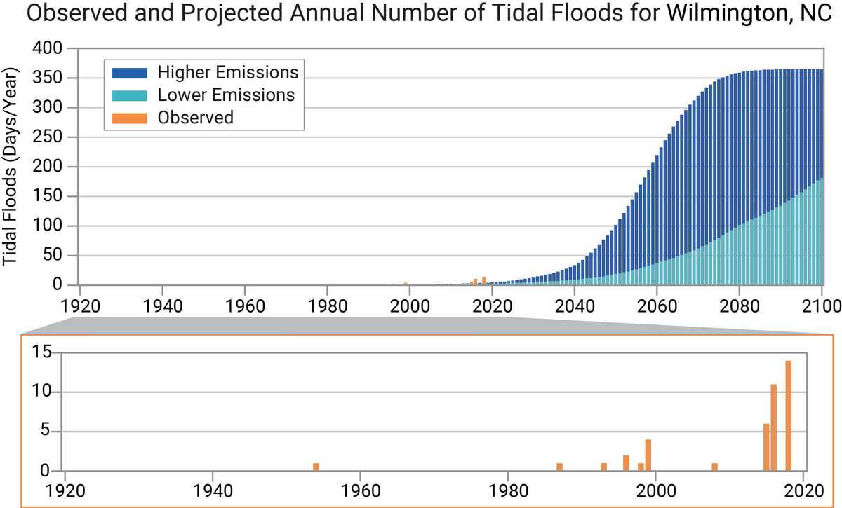

Slide 14
Thank You!

